Slide 1
The Future of Virtual Machines:
A VMware Perspective
Ed Bugnion
Co-founder, VMware Inc.
JUGS
September 27, 2001

Slide 2
Outline
Historical Perspective
MultipleWorlds™ Technology
  Technology and Products
Technology
  Hosted and Host-less architectures
  Performance
4 Usage scenarios

Slide 3
The Problem (1960’s)
Operating System
Mainframe Hardware
Notes:
Benefits:
Mobility
Security
Multiple instances

Slide 4
The Solution (1960’s)
Operating System
Operating System
Mainframe Hardware
Mainframe Hardware
Notes:
Benefits:
Mobility
Security
Multiple instances

Slide 5
Virtual Machine Monitors
App
App
App
App
CMS
MVS
CMS
CMS
IBM VM/370
IBM Mainframe
A thin software layer that sits between hardware and the operating system— virtualizing and managing all hardware resources

Slide 6
Old idea from the 1960s
IBM VM/370 – A VMM for IBM mainframe
  Multiple OS environments on expensive hardware
  Desirable when few machine around
Popular research idea in 1960s and 1970s
  Entire conferences on virtual machine monitor
  Hardware/VMM/OS designed together
Interest died out in the 1980s and 1990s.
  Hardware got cheap
  Operating systems got more more powerful (e.g multi-user)

Slide 7
A return to Virtual Machines
Disco: Stanford research project (1996-):
  Run commodity OSes on scalable multiprocessors
  Focus on high-end: NUMA, MIPS, IRIX
Hardware has changed:
  Cheap, diverse, graphical user interface
  Designed without virtualization in mind
System Software has changed:
  Extremely complex
  Advanced networking protocols
  But even today :
    Not always multi-user
    With limitations, incompatibilities, …

Slide 8
The Problem Today
Operating System
Intel Architecture
Notes:
Benefits:
Mobility
Security
Multiple instances

Slide 9
The VMware Solution
Operating System
Operating System
Intel Architecture
Intel Architecture
Notes:
Benefits:
Mobility
Security
Multiple instances

Slide 10
VMware™ MultipleWorlds™ Technology
App
App
App
App
Win
2000
Win
NT
Linux
Win
2000
VMware MultipleWorlds
Intel Architecture
A thin software layer that sits between Intel hardware and the operating system— virtualizing and managing all hardware resources

Slide 11
MultipleWorlds Technology
World
App
App
App
App
Win
2000
Win
NT
Linux
Win
2000
VMware MultipleWorlds
Intel Architecture
A world is an application execution environment
with its own operating system

Slide 12
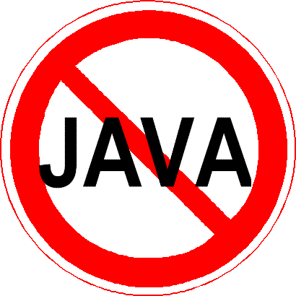
MultipleWorlds Technology
World
App
App
App
App
Win
2000
Win
NT
Linux
Win
2000
VMware MultipleWorlds
Intel Architecture
A world is an application execution environment
with its own operating system

Slide 13
Challenges
Virtualization of IA-32
Hardware Diversity
Acceptance

Slide 14
VMware Workstation– Screen shot

Slide 15
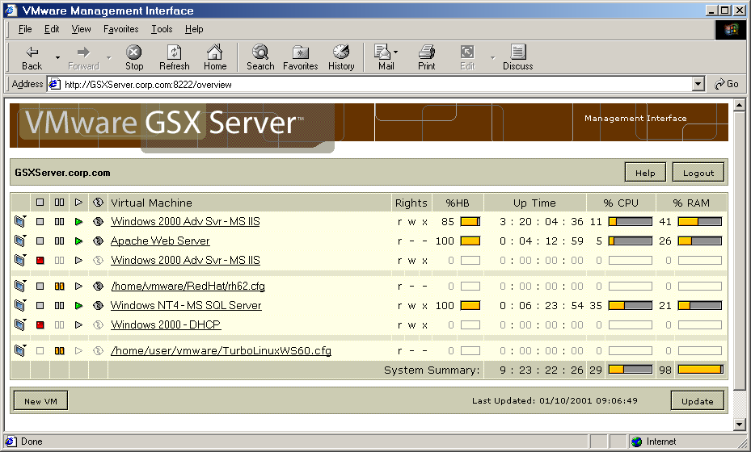
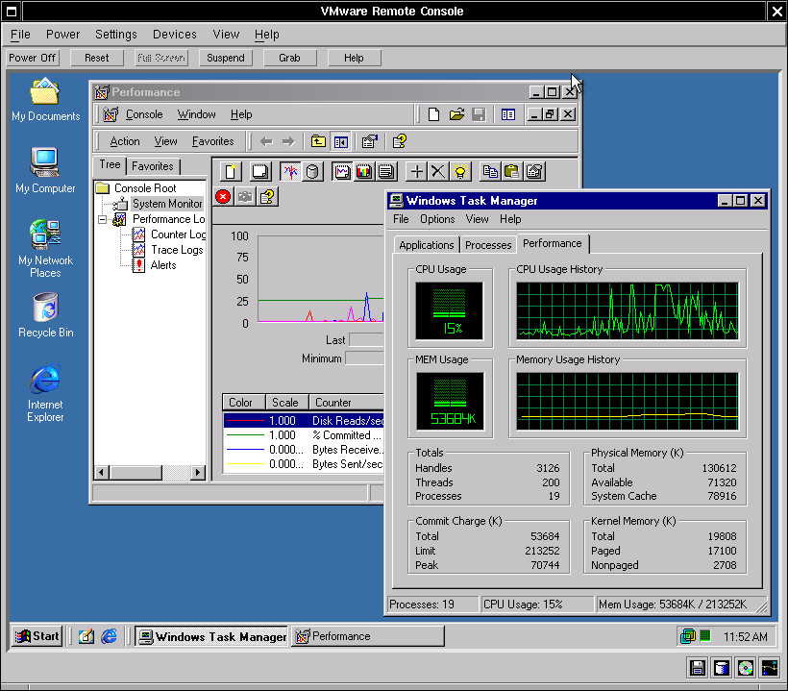
VMware Server – Screen Shot
Web-based management interface
  Stop, start, suspend/resume virtual machines
  Monitor CPU usage
  Run scripts
  Secure user authentication
Remote Console
  Windows and Linux versions
  Full desktop display
  Full mouse and keyboard support
  Secure user authentication
  Access VMware configuration editor
Notes:
With GSX Server all virtual machine management tasks can be performed remotely. The GSX Server web-based management interface is web browser-based, so virtual machines running your server applications can be administered from any location with network access to the GSX Server.
The GSX web-based management interface lets you control any of the virtual machines on a GSX server. You can do a virtual power cycling by stopping and restarting a virtual machine, or suspend and resume virtual machines.
The web-based management interface browser display graphically shows the status of each virtual machine running on a GSX Server, including its CPU usage.
From the web-based management interface, an administrator can run any pre-defined GSX Server Perl scripts that automate functions such as setting the network identity of a virtual machine, starting server applications, or performing corrective procedures to resolve server problems.
Of course, it’s vital to protect a GSX Server from unwanted access, so VMware includes a secure authentication feature to ensure that only authorized users can connect to a GSX Server’s management interface.

Slide 16
VMware Products
VMware Workstation
  Run Multiple Operating Systems on your workstation
  Hosted Architecture
  Available for Linux and Windows hosts
VMware GSX Server
  Run multiple servers on your server
  Hosted Architecture
  Available for Linux hosts and soon Windows hosts
VMware ESX Server
  + Quality of Service
  + High-performance I/O
  Host-less Architecture

Slide 17
Virtual Hardware
Parallel Ports
Serial/Com Ports
Monitor
(VMM)
Floppy Disks
Ethernet
Sound Card
Keyboard
Mouse
IDE Controller
SCSI Controller

Slide 18
Attributes of MultipleWorlds Technology
Software compatibility
  Runs pretty much all software
Low overheads/High performance
  Near “raw” machine performance
Complete isolation
  Total data isolation between virtual machines
Encapsulation
  Virtual machines are not tied to physical machines
Resource management

Slide 19
VMware Core Technology
The present

Slide 20
Virtualization through Ring Compression
Virtual Machine Monitor (VMM) runs at ring 0
Kernel(s) run at
ring 1
Requires that CPU
is virtualizable
3
user
kernel
2
1
0
VMM

Slide 21
Classification of processor architectures
Strictly virtualizable processor architectures
  Can build a VMM based on trap emulation exclusively
    No software running inside the VM cannot determine the presence of the VMM (short of timing attacks)
  Examples: IBM S/390, DEC Compaq Intel Alpha, PowerPC
(Non-strictly) virtualizable processor architectures
  Trap emulation alone is not sufficient and/or not complete
    E.g. instructions have different semantics at various levels (sufficient)
    E.g Some software sequences can determine the presence of the VMM (complete)
  Examples: IA-32, IA-64
Non virtualizable processor architectures
  Basic component missing (e.g. MMU, …)

Slide 22
Hosted VMware Architecture
Host Mode | VMM Mode
VMware, acting as an application, uses the host to access other devices such as the hard disk, floppy, or network card | The VMware Virtual machine monitor allows each guest OS to directly access the processor (direct execution)
VMware achieves both near-native execution speed and broad device support by transparently switching* between Host Mode and VMM Mode.
Guest OS Applications
Guest Operating System
Host OS Apps
VMware App
Virtual Machine
Host OS
VMware Driver
Virtual Machine Monitor
NIC
PC Hardware
Disks
Memory CPU
*VMware typically switches modes 1000 times per second

Slide 23
Hosted VMM Architecture
Advantages:
  Installs and runs like an application
  Portable – host OS does I/O access
  Coexists with applications running on the host
Limits:
  Subject to Host OS:
    Scheduling Decisions
    Resource management decisions
    OS failures
  Performance overheads:
    World Switch
    I/O access
Usenix 2001 paper:
  J. Sugerman, G. Venkitachalam and B.-H. Lim, “Virtualizing I/O on VMware Workstation’s Hosted Architecture”.

Slide 24
Virtualizing a Network Interface
VMApp
Guest OS
Virtual Network Hub
Host OS
NIC Driver
Virtual Bridge
Physical Ethernet
VMDriver
VMM
NIC Driver
Physical NIC
PC Hardware

Slide 25
Experiment – TCP Throughput
Host
TCP
Host
Host
Host
VM
TCP
Native
Virtual Machine
Two speed of host:
  Standard -- 733 MHz Pentium III
  Slower -- 350 MHz Pentium II
100 megabit Ethernet connected via crossover cable
Host and Guest OSes are Linux 2.2.x kernels
3 optimizations that reduce number of World switches

Slide 26
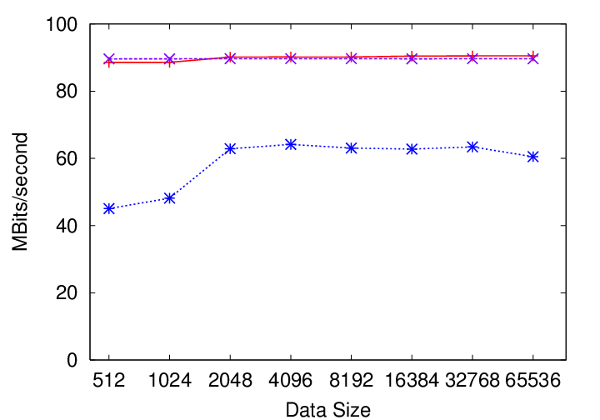
Optimized Performance– 733 MHz
Native
VM/733 MHz
Optimized
VM/733 MHz
Version 2.0

Slide 27
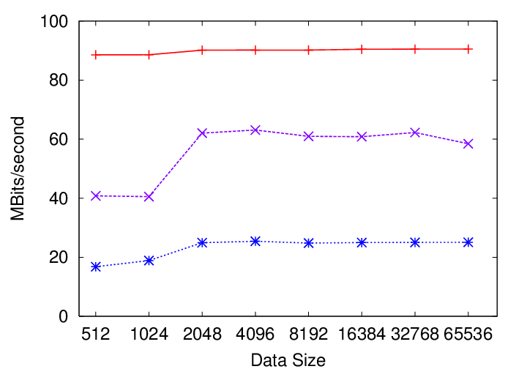
Optimized Performance– 350MHz
Native
VM/350 MHz
Optimized
VM/350 MHz
Version 2.0

Slide 28
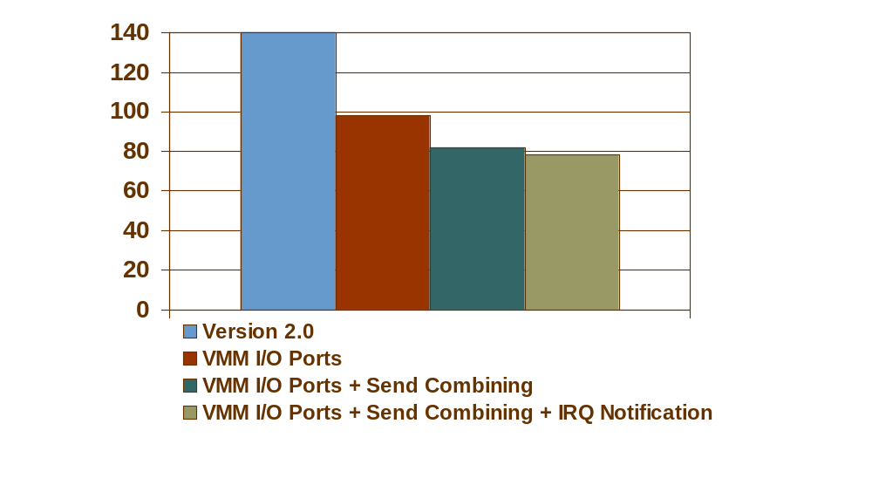
CPU Utilization – VM/PC-733
Percent
Native PC-733 is I/O bound with under 20% CPU utilization

Slide 29
Beyond the Hosted Architecture
Limits of the Hosted Architecture:
  World switch overhead – especially I/O
  Hard to make QoS guarantees
  Depend on the Host
ESX Server Architecture:
  Eliminate the host
  All applications run in a VM
  Looks closer to a traditional VMM system

Slide 30
ESX Server Architecture
Guest
OS
Guest
OS
Guest
OS
Guest
OS
Console
OS
VMM
VMM
VMM
VMM
Scheduler
Memory
Mgmt
SCSI
Driver
Ethernet
Driver
VMkernel
x86 SMP
Hardware
nic
Memory
disk
nic
CPU
NIC

Slide 31
High Performance Network
Ethernet and Gigabit Ethernet
Each virtual adapter has its own MAC address
No world switch !
Stub
Driver
Stub
Driver
Stub
Driver
VMM
VMM
VMM
NIC
specific
drivers
VMware
Server
VMM
VMware Ethernet Driver
VMware Ethernet Driver
NIC
NIC
x86 SMP
Hardware
Shared Device
Exclusive Device

Slide 32
Intra-system networking
Executes at memory speed
Stub
Driver
Stub
Driver
Stub
Driver
Stub
Driver
NIC
specific
drivers
VMware
Server
VMM
Virtual Network
x86 SMP
Hardware

Slide 33
Usage Scenarios
4 Examples on Desktops and Servers

Slide 34
Scenario #1:
Testing and Deployment
Production
VM
Production
VM
Develop-
ment
VM
QA
VM
Production
VM
Production
VM
Develop
Test
Deploy
Notes:
Actual quote from Paine Webber’s CIO Scott Abbey
"We have a significant issue with the proliferation of servers to support large-scale applications. Most applications won't run well on a server with other applications -- you need dedicated servers. That is inconvenient to say the least. And each one needs its own fail-over gear.
"A set of technologies that would facilitate merging those into a smaller set of servers would be highly advantageous … What I'm actually describing is a mainframe."

Slide 35
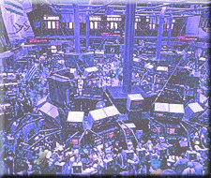
Major Wall Street
Investment Banking Firm
Testing and Deployment
Challenge Solution
Testing & deployment was error-prone and expensive
Test and deploy
in VMware worlds
“VMware allows us to deliver well- tested and more reliable solutions in a shorter time frame at substantially lower costs."
Notes:
One of world’s leading financial services companies
Problem:
Testing and deploying upgrades to a trade-processing application over heterogeneous, geographically distributed systems was error-prone and expensive
Solution:
Develop, test and deploy upgrades in VMware worlds
Merrill Lynch reduces costs and simplifies management

Slide 36
Scenario # 2:
Server Consolidation
Web Server
Database Server
App Server
Web Server
App Server
App Server
Web Server
App Server
Web Server
Database Server
VMware MultipleWorlds + Physical Hardware

Slide 37
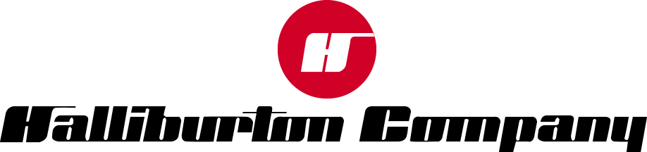
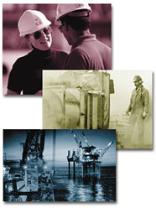
Server Consolidation
The Challenge The Solution
One database per oil well,
one server per database
Run each database in
a VMware world
“We’re able to run up to 10 database servers on a single server, which allows us to provide mainframe levels of reliability and data security at much lower cost."
oil well photo
Notes:
Major oil services company with annual revenues of $14.9 billion
Problem:
Each oil well requires its own database; Windows can only run one instance of that database on each machine
As the number of oil wells increases, management and maintenance of hundreds of small database servers become complex and expensive
Solution:
Run each oil well database server in a VMware world
Halliburton greatly reduces the number of servers it needs to maintain and manage the databases

Slide 38
Scenario #3:
Application Compatibility
Some applications require their OS
Some solutions require multiple applications
Appliances provide solutions
→ VMware in Appliances

Slide 39
Cisco Content Engine 590
Media
Server
RealPlayer
Server
Windows 2000
Linux
IP chain
Intel Appliance

Slide 40
Scenario #4:
Security Solutions
Traditional tension : Security vs. Usability
  Secure systems are not that usable
    E.g: require some particular OS setups
  Flexible systems are not that secure
    Many documented examples
Virtual Machines allow:
  Secure Host
    that ensures the security of the whole system
  Flexible, Usable Virtual Machines
    that play no role in the security of the whole system

Slide 41
National Security Agency NetTop
Classified
VM
Internet
VM
VPN
Firewall
SE-Linux

